Slide 1
Large Language Models
Attention Mechanisms in Transformers.pptx

Slide 2
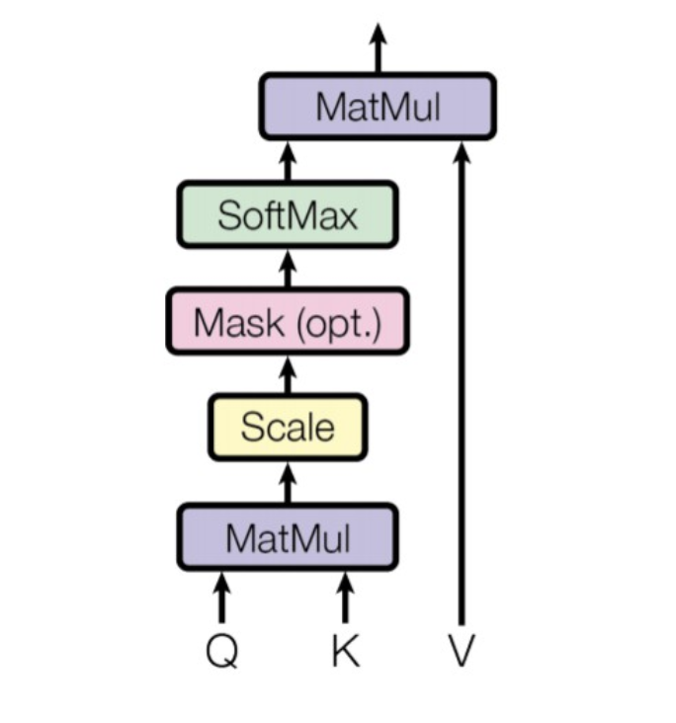
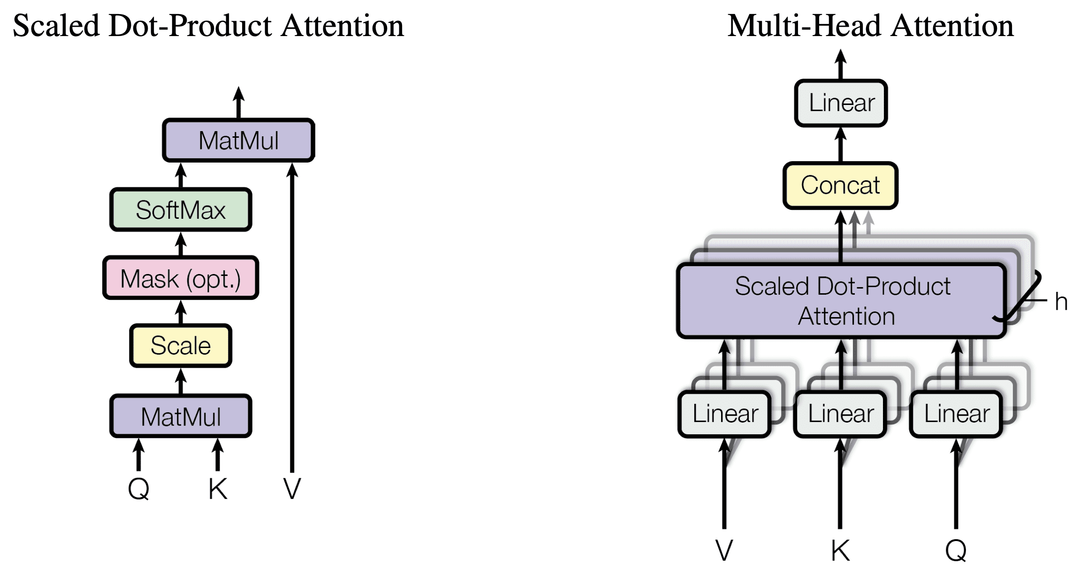
Slide 3
Core Concept: Self-attention calculates a weighted sum of input sequence elements. Each element's weight reflects its relevance to other elements, allowing the model to focus on crucial parts for output generation. These weights are learned during training. Mechanics: Uses three matrices derived from input embeddings: Queries (Q) – what the model seeks; Keys (K) – what each element offers; Values (V) – the information content. Attention weights: Attention(Q, K, V) = softmax(QK<sup>T</sup> / √d<sub>k</sub>)V, where d<sub>k</sub> is the key vector dimension. The scaling prevents exploding gradients.

Slide 3
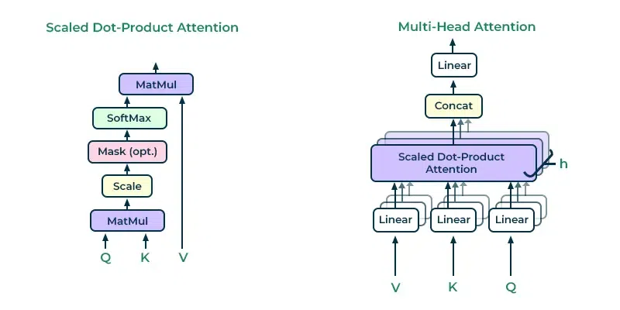
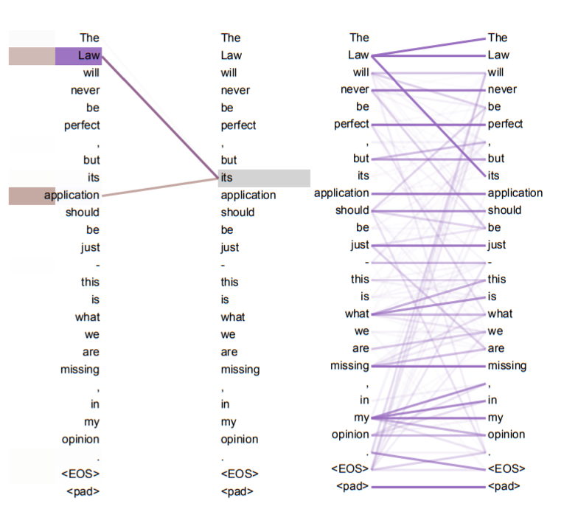
Slide 5
Example: In the sentence "The quick brown fox jumps over the lazy dog," self-attention helps the model understand that "jumps" relates to "fox" and "over" to both "jumps" and "dog." Weights reflect these relationships. Multi-Head Attention: Instead of single Q, K, V, it uses multiple sets, enabling the model to attend to different aspects simultaneously. Each head learns different relationships; outputs are concatenated and linearly transformed.

Slide 4
Slide 7
Self-attention is fundamental to many NLP applications: - Machine Translation: Aligning words across languages. - Text Summarization: Identifying key sentences/phrases. - Question Answering: Locating relevant text sections. - Sentiment Analysis: Assessing overall sentiment by considering word relationships. - Named Entity Recognition: Identifying entities based on context.

Slide 5
Slide 10
Core Concept: Assigns weights to input sequence parts based on relevance to the current output. This relevance is determined by attention scores (often using dot-product) and normalized (softmax) into a probability distribution for a weighted input sum (context vector). Multiple Heads: Extends single-head by using multiple sets of learned parameters (weights), creating multiple attention mechanisms, each focusing on different aspects of the input. The context vectors from all heads are concatenated and linearly transformed.

Slide 6
Slide 12
Mathematical Formulation: For input matrix X, each head 'i': Qi = XWQi, Ki = XWKi, Vi = XWVi; Attention_Scoresi = Qi(Ki)T; Scaled_Attention_Scoresi = Attention_Scoresi / sqrt(dk); Attention_Weightsi = softmax(Scaled_Attention_Scoresi); Context_Vectori = Attention_WeightsiVi; Output = Linear(Concat(Context_Vector1, ..., Context_Vectorh)).Example (Machine Translation): Different heads focus on different aspects (e.g., subject-verb-object, prepositional phrases). Combining these insights yields a more accurate translation.

Slide 7
Slide 14
Multi-head attention offers: - Parallel processing: Speeds up computation. - Diverse relationship capture: Richer contextual representations. - Improved model performance: Significantly better results on various tasks.

Slide 8
Slide 17
Dot Product: Measures similarity between query (Q - what the model seeks) and key (K - potential matches) vectors. High dot product implies high similarity. Scaling: The dot product is scaled down by √dk (dk = key vector dimension) to prevent dot products from becoming too large, which can saturate the softmax and lead to unstable training.

Slide 9
Slide 19
Softmax: Transforms scaled dot products into probabilities (weights summing to 1). Higher dot products lead to higher probabilities. Weighted Sum: Attention weights are used to compute a weighted sum of value (V - information content) vectors, creating a context vector incorporating information from relevant input parts.

Slide 10
Slide 21
Mathematical Formulation: Attention(Q, K, V) = softmax(QK<sup>T</sup> / √d<sub>k</sub>)V Example: In the sentence "The quick brown fox jumps over the lazy dog," focusing on "fox," the dot products would show higher similarity between "fox" and "jumps" than with "the" or "lazy." Softmax gives attention weights, creating a context vector capturing "fox's" context.

Slide 11
Slide 24
Uses linear transformations to compute Q, K, and V matrices from input embeddings (matrix X): Q = X * Wq K = X * Wk V = X * Wv Attention Weights = softmax(Q * KT / sqrt(dk)) Context Vector = Attention Weights * V Wq, Wk, Wv are learned weight matrices.

Slide 12
Slide 26
Implemented using matrix multiplications (efficient in PyTorch/TensorFlow). The scaling factor (1/sqrt(dk)) is crucial for numerical stability. Multi-head attention extends this by using multiple sets of (Wq, Wk, Wv). Example (Machine Translation): When translating "chat" (cat), the attention mechanism might assign higher weights to "cat" and "animal" in the English sentence.

Slide 13
Slide 28
Advantages: Simple to implement, computationally efficient, forms the basis for advanced mechanisms. Disadvantages: Less expressive than sophisticated mechanisms for long sequences; computational cost still scales quadratically with sequence length.

Slide 14
Slide 31
Machine Translation: Aligns words/phrases between source and target languages, improving accuracy and fluency, especially for long sentences. Text Summarization: Focuses on key sentences/phrases, generating concise and informative summaries (abstractive summarization).

Slide 15
Slide 33
Question Answering: Focuses on relevant context parts to accurately extract answers, especially for complex questions. Sentiment Analysis: Focuses on sentiment-bearing words (adjectives, adverbs, negations) for more accurate sentiment classification.

Slide 16
Slide 35
Named Entity Recognition (NER): Focuses on words and context to improve entity recognition accuracy. Text Classification: Focuses on discriminative words/phrases to improve classification accuracy.

Slide 17
Slide 38
Core Concepts: Weighted averaging; Q (what the model seeks), K (what's available), V (information content); similarity scores (often dot-product); softmax normalization; context vector. Types: Self-attention (Q, K, V from same input), Channel attention (weights for channels), Spatial attention (weights for spatial locations), Multi-head attention (multiple Q, K, V sets), Vision Transformers (replace/augment CNNs with self-attention).

Slide 18
Slide 40
Applications: Image classification, object detection, image segmentation, image captioning, video understanding. Example (Self-Attention in Image Classification): Query represents identifying a cat's head; keys are parts of the feature map; high weights to head-like regions; context vector strongly represents the cat's head, aiding classification.

